Slide 1
Mushroom Classification
File created on: 4/30/2024 12:04:38 PM

Slide 2
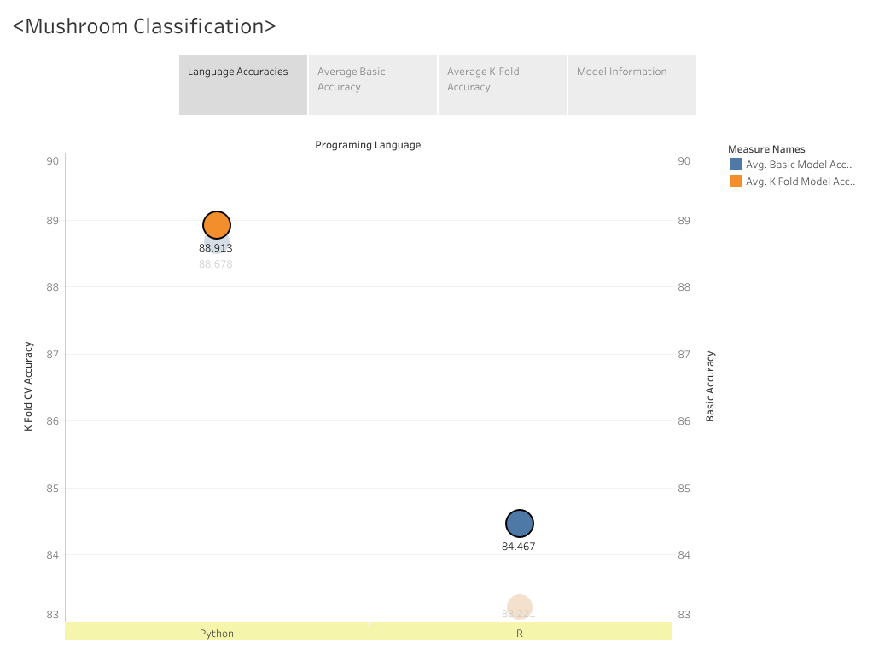

Slide 3
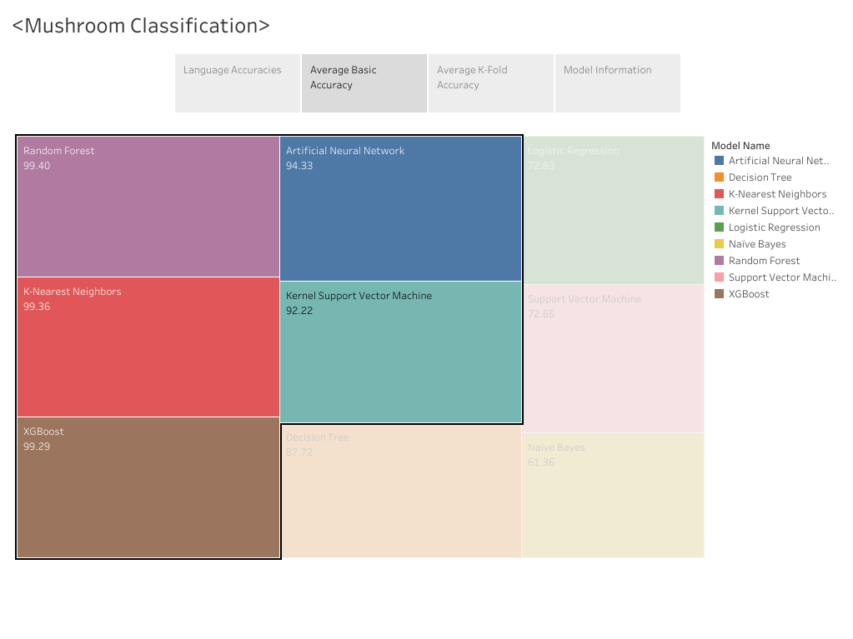

Slide 4
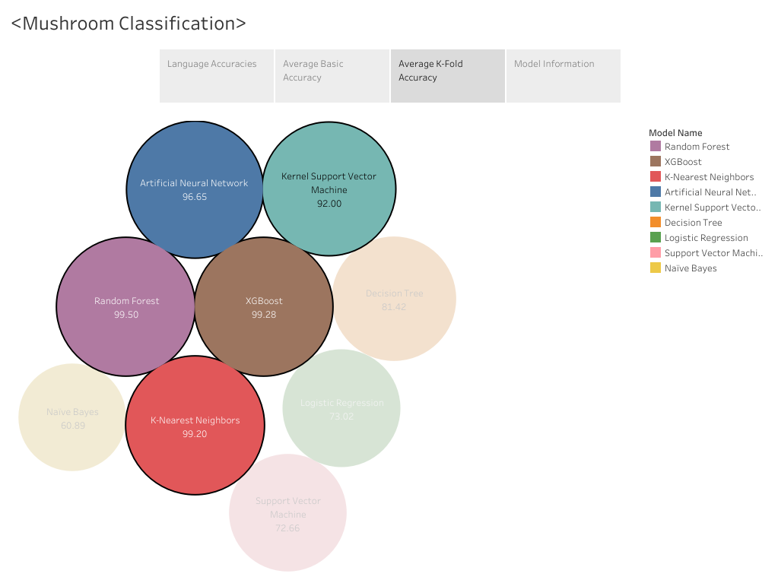

Slide 5
